Slide 1



Welcome!
Curriculum Meeting for Parents of Children in Year Four

Slide 2
Meet the Staff
Teachers:
Class 9 – Miss Whitfield
Class 10 – Miss Entwistle

Slide 3

Maths
Daily Maths lessons
Arithmetic lessons
Place Value
Add and Subtract
Length and Perimeter
Multiplication and Division
Area
Fractions
Decimals
Money
Time
Statistics

Slide 4

Reading
Reading Comprehension
  Focuses on 7 key areas:
    Reading skills , Literal, Inferential, Text structure, Language features, Purpose and Cultural/historical features
New Reading books have been issued
Please read with your child 3 x a week and record this in their reading record
iPad Reading – your child will do a reading activity on the iPad each week.

Slide 5

Writing
In writing, we look through various writing genres. At the end of each genre, we will create our own piece. We will identify the features of each genre and embed Year 4 grammar within each genre.
Genres:
Narratives
Recount
Newspapers
Instructions
Non-Chronological Reports
Poetry
Handwriting – practising the school’s cursive script and formation of letters correctly.

Slide 6
Grammar
Weekly Grammar lessons focusing on Year 3 and 4 Grammar
Sentence Types
Clauses of a sentences and Word Classes
Vocabulary e.g. fronted adverbials, expanded noun phrases, coordinating conjunctions and subordinating conjunctions.
Daily Writing Skills activity to be completed in the morning, focusing on aspects SPaG.

Slide 7

Spelling
  Spelling test every Thursday
  We are using a spelling scheme this year called Essential Spelling that was introduced last year.
  Spelling lessons 3 x week.
  On Lesson 1 (Thursday) spelling sound or rule is introduced.
  On Friday a SACAWAC is sent home as part of their homework for your child to learn the spellings.
  The other two lessons we do more work on the spelling sound/rule.

Slide 8

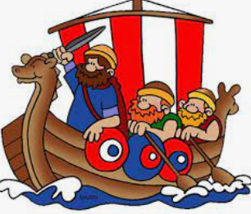
Topics for Autumn Term
Science: States of Matter
History: Settlers and Invaders (The Saxons and Vikings)
Science: Sound
Geography: Earthquakes and Volcanoes

Slide 9
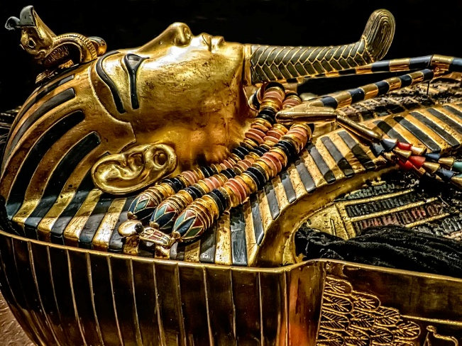
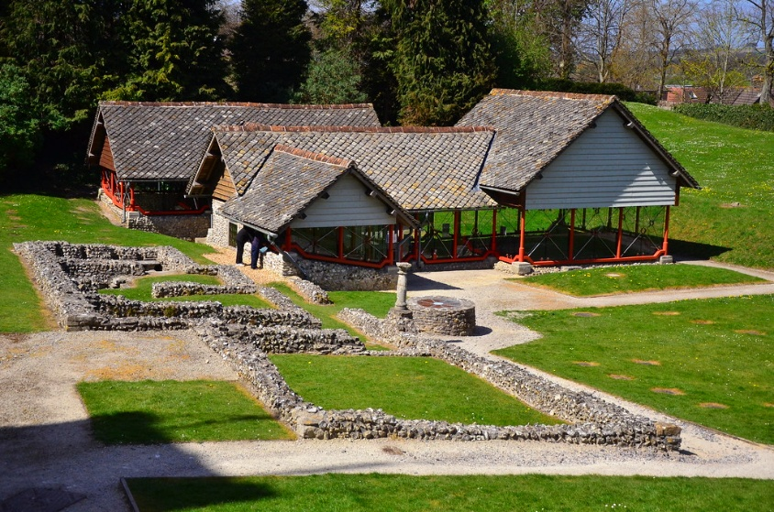
Our Trip
This year our trip will be to the Tutankhamun Exhibition in Dorchester, and we will also visit the Roman Town House in Dorchester.
Our trip will be in the Summer Term.

Slide 10

Religious Education
Autumn 1: Gospel: What kind of world did Jesus want?
Autumn 2: Incarnation: What is the Trinity?

Slide 11

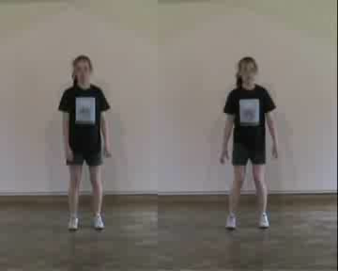
PE
Personal, Social, Cognitive, Creative and Application of Skills
One outside and one indoor lesson a week.
Please ensure your child wears the appropriate kit to school on PE days on:
Monday and Friday (whilst swimming) (Class 9)
Wednesday and Thursday (Class 10)
Black shorts (not short shorts)/jogging bottoms, yellow T-shirt, & trainers or daps.
Earrings removed or taped for their safety.
If there is a medical reason why they can’t take part in PE, please can you write a note/ tell us in the morning or else they will be expected to participate.
Swimming Year 4 focus.

Slide 12
Routines and Expectations - Homework
Homework will be set every Friday and will need to be returned, completed by the following Wednesday.
There is a new homework format this year:
Maths
Handwriting
SACAWAC
In addition to their homework, daily TTR practise is advised due to our Multiplication Check in June.
Reading should be done frequently throughout the week, aim for 3 times, in addition to the set homework.
Spellings will be sent home to learn and these should be practised throughout the week, ready for their spelling test which is on a Thursday.

Slide 13
Year 4 Multiplication Check
In June, your child will sit their Year 4 Multiplication Check test.
There are 25 questions and these cover all times tables.
Individual log ins are created on the day and children will complete their test on their iPads.
We will practise regularly in school prior to the test.
Children will have 6 seconds to answer each question, so speed of recall is really important.
Questions appear in a very similar way to how they appear on TimesTables Rockstars, which is why we recommend this website when practising for homework.
We practice TTR daily. On the website you can view their heat map which shows which timetables they are working on.

Slide 14
General Reminders
Children should bring their reading book into school everyday.
Water bottles (clearly named and containing only water) should be brought into school.
As we move into the Autumn Term, please ensure your child has a coat (with a hood and clearly named) with them every day.
Uniform: no trainers, no hooped earrings, hair tied back.

Slide 15


