Slide 1


Curriculum Meeting:
Year 6

Slide 2
Teachers
Class 13 – Mrs Camp
Class 14 – Mr Barker

Slide 3
Maths
Five, one- hour lessons each week with arithmetic in the first ten minutes of every morning.
Important skills and knowledge needed as soon as possible:
Place value: being able to read and write numbers up to 10million and understand the value of each digit within them.
Calculations: being able to use the formal methods for addition, subtraction, multiplication and division (including long division).
Fractions: being able to understand that fractions are part of a whole; be able to calculate simple fractions of amounts.
Number Facts: it is important that children can recall multiplication and division facts or use methods to find them; recognise some fraction, decimal and percentage equivalents.

Slide 4
1) Number and Place Value
2) Calculations
3) Fractions, decimals and percentages
4) Ratio and proportion
5) Measures
6) Geometry
7) Statistics
8) SATs Revision

Slide 5

Reading
  Comprehension focus:
  Literal
  Inferential
  Word Meaning
  Summarising and deduction
  Predicting
  Text structure
  Language features/ purpose
  Individual Reading
  Reading stamina
  Reading for enjoyment
  Reading at home

Slide 6
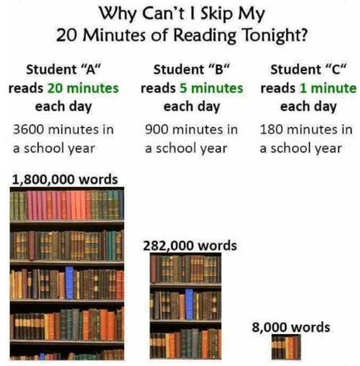
Reading

Slide 7
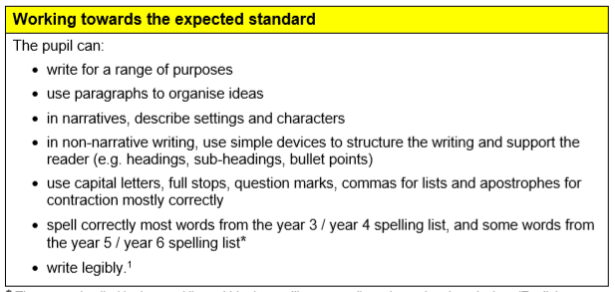
Writing

Slide 8
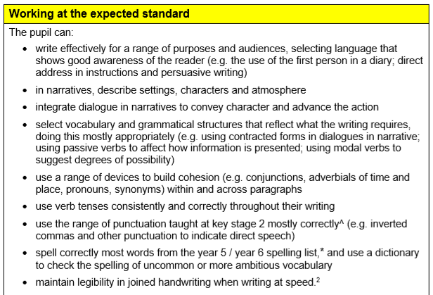
Writing

Slide 9
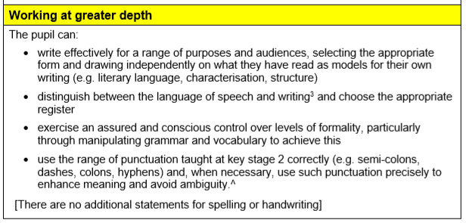
Writing

Slide 10
Writing
Writing Skills:
10 minutes looking at previous areas of the curriculum and misconceptions
Spelling: new rules – prefixes and suffixes (able, ible, sion, tion, im, in, de etc.)
The year 5/6 statutory words (as outlined by the National Curriculum)
Handwriting

Slide 11
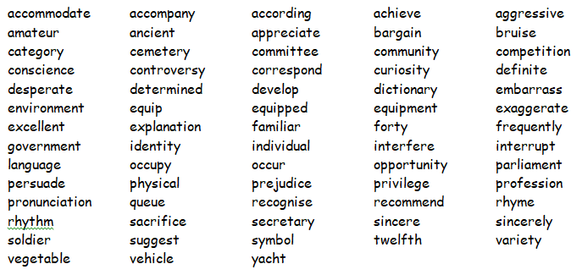
Statutory Spellings

Slide 12
RE
Unit 1: The Kingdom of God: The Parables
Unit 2: Islam: What is the best way for a Muslim to show commitment to God?
Unit 3: Gospel: What would Jesus do?
Unit 5: Creation and Science: Conflicting or complimentary?
Unit 4: Salvation: What difference does the resurrection make for Christians?
Unit 6: Islam: Does belief in Akhirah (life after death) help Muslims lead good lives?

Slide 13
PE
REAL PE: Personal, Social, Cognitive, Creative and Application of Skills
Modified Games as well as traditional games
Children must have appropriate kit:
Black shorts, or dark track-suit trousers
Yellow t-shirt
Trainers
Hats and gloves (as winter approaches).
Earrings removed or taped.
If there is a medical reason why they can’t take part in PE, please inform your class teacher
Extra-Curricular Opportunities: football, cross-country, netball, hockey, tennis, athletics and more.

Slide 14
Other Subjects and topics that are covered throughout the year.
Science: electricity, light, evolution and inheritance, classification and human anatomy.
Art and DT: Chocolate making, Mayan Masks, Model planes, Kandinsky, Ben Kwok and Ben Enwonwu.
Geography: rivers, trade.
History: WW2, Maya Civilisation
Computing: Coding, Spreadsheets, Quizzing, Text, Blogging, Yearbook creation
French: Describing people, parts of the body, food, revision of previous learning
Music: Listen and appraise, composer study (Wagner), Garageband, Year 6 production, Jazz, Rap

Slide 15
Routines and Expectations.
P.E. days and kit:
Class 14: Monday and Tuesday
Class 13: Tuesday and Wednesday
Swimming: Catch-up programme in the Summer term for those that have not yet met the standard (swim 25m)
Homework:
Given out on Friday; expected by the following Wednesday.
  Maths: A sheet that will focus on the fundamentals of maths: calculation, fractions, decimals and percentages
  Handwriting: the children will be given a passage to copy in their neatest handwriting. Those who have gaps will be given an adapted sheet that will help them consolidate letter formation and joins.
  Spellings: Children will receive a SACAWAC to complete.
  Reading: children must read regularly at home. This does not need to be a school book but encourage ANY form of reading.

Slide 16
SATS
Week Beginning: 10th May
Monday: Grammar and Spelling (45mins)
Tuesday: Reading (60mins)
Wednesday: Maths 1 (30mins),
Maths 2 (40mins)
Thursday: Maths 3 (40mins)
Required Scores for the expected level: 2026
Subject | Total Marks | Percentage
Grammar and spelling | 34/70 | 49%
Reading | 25/50 | 50%
Maths | 56/110 | 51%

Slide 17
Trips
Spring Term:
Wednesday 3rd February 2027: Bath Theatre Show
Cost: Approximately £30-40
Details will be sent in due course once all arrangements have been finalised.
Summer Term:
Bowling: TBC

Slide 18











SATs revision books:
Complete the order form and return to school by Friday 16th October.
By ordering through school, you can receive 50% off.

Slide 19
Secondary Schools
The local schools are now having their Open Days. Should you wish to take your child to these days, we do ask that you let the office know that your child will be late in/collected during the morning depending on when you are going.
The website for applying is:
https://www.somerset.gov.uk/education-and-families/starting-at-a-secondary-or-upper-school-in-september/
There is also an admissions guide which can be found at:
https://www.somerset.gov.uk/education-and-families/secondary-admissions-guide/
IMPORTANT - the closing date for admissions is 31st October 2026.
You will be informed of your child’s place at the beginning of March 2027.

Slide 20
A final note- thank you:
According to UK research into how the family influences school success, the single most important factor is not income, social class or parental education but the level of interest and involvement shown by the parent or parents.

